Slide 1
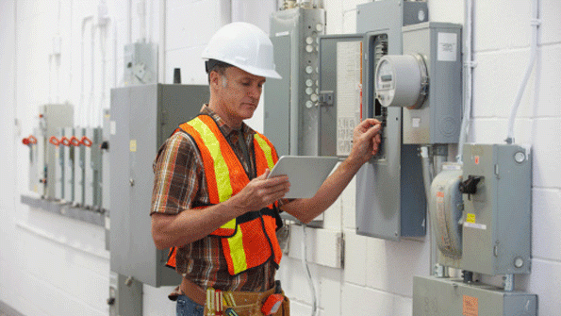
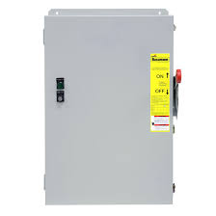
Electrical Hazards in Construction
Bureau of Workers’ Compensation
PA Training for Health & Safety (PATHS)
Notes:
Electricity is essential to modern life, both at home and on the job. Some employees such as engineers, electricians, electronic technicians, and power line workers, among them, work with electricity directly. Others, like office workers and sales people, work with it indirectly. Perhaps because it has become such a familiar part of our daily life, many of us don't give much thought to how much our work depends on a reliable source of electricity. More importantly, we tend to overlook the hazards electricity poses and fail to treat it with the respect it deserves.

Slide 2
Main Topics
Electrical Hazards – What is Electricity?
1. Improper Grounding
2. Exposed Electrical Parts
3. Inadequate Wiring
4. Damaged Insulation
5. Overloaded Circuits
6. Damaged Tools & Equipment
7. Wet Conditions
8. Overhead Power Lines
B. Accident Prevention:
1. Personal Protective Equipment
2. Inspect Tools & Cords
3. GFCIs
4. Lock-Out/Tag-Out
Notes:
This presentation will cover the following:
Electrical Hazards – What is Electricity?
1. Improper Grounding
2. Exposed Electrical Parts
3. Inadequate Wiring
4. Damaged Insulation
5. Overloaded Circuits
6. Damaged Tools & Equipment
7. Wet Conditions
8. Overhead Power Lines
B. Accident Prevention:
1. Personal Protective Equipment
2. Inspect Tools & Cords
3. GFCIs
4. Lock-Out/Tag-Out

Slide 3
Electrical Hazards
Electrical hazards are one of the greatest hazards on a construction sites. (Electrocution can be a result of an electrical hazard).
This program will help you recognize common electrical hazards.
The symbols will tell you if the situation in the picture is either safe or not safe.
Safe
Not Safe
Notes:
Electrical hazards are one of the most serious hazards found on a construction sites (Electrocution can be a result of an electrical hazard). Electrical hazards can actually cause serious burns on your skin, place you in a coma or kill you. Electrical hazards while extremely dangerous, are also avoidable by being prepared to recognize these conditions.
This program will help you recognize common electrical hazards and show you ways to decrease those hazards at your job site. By the end of this program, you will be able to recognize and avoid these hazards.
Throughout this program, you will be shown examples of safe and unsafe conditions. Two different symbols will be used to represent safe and unsafe conditions. The red “No” symbol is used to denote unsafe conditions, and the green “Yes” checkmark will be used to show safe conditions.

Slide 4
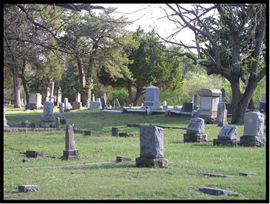
Electrical Hazard Statistics
Each year workers die from contacting electric current. On Average
247 workers die after contacting electric current.
124 are construction workers.
Nearly 4.5% of all deaths result from electrocutions.
Notes:
Each year workers die after contacting electric current. According to the latest Bureau of Labor Statistics, during a recent year over 5,703 occupational fatalities occur annually. Of all occupational fatalities, 247 were caused by contacting electric current, 124 (50%) of all electrical fatalities were in the construction industry.
Overall, nearly 4.5% of all occupational fatalities are from contacting electric current.

Slide 5
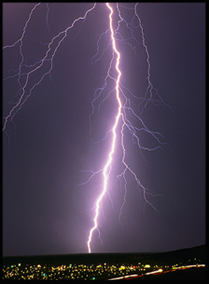
What is Electricity?
Electricity is a natural energy force.
Electricity is also a man made energy force.
It is essential to modern life and taken for granted everyday.
Notes:
Electricity is energy made both by man and by nature. As a source of energy, electricity is used without much thought about the hazards it can cause, and has become essential to our lives. Because it is a familiar part of our lives, it is often treated with little caution. As a result, approximately one worker is electrocuted on the job every day of every year!

Slide 6
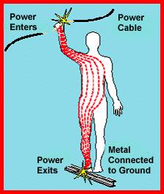
What is Electricity?
Electricity flows through conductors.
Conductors include: metals, water, the Earth and the human body.
Electricity must have a complete circuit or path to flow.
Notes:
Man-made electricity consists of energy flowing through copper wire, also called electrical current. This electrical current goes to homes, businesses, and construction sites everyday from a power station hundreds of miles away. Lightning is electricity made by nature and extremely dangerous.
Electricity flows through some materials better than others. Materials that have very little resistance to the flow of electrical current are called “conductors”. Typical conductors are metals such as copper, water, the earth, and the human body.
Electrical current flows through conductors from one point to another and must have a completed path to flow. If the path breaks, then electricity cannot flow and equipment does not work.

Slide 7
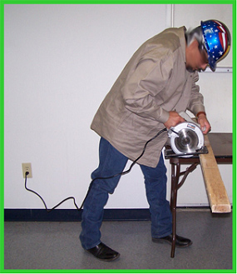
How Electricity Works
When electrical tools are working properly a complete circuit is maintained between the tool and the energy source.
Notes:
As shown in this picture, electricity comes from the outlet on the wall, through the wire, and then to the saw. Then following the path, the electricity goes through the saw, through the wire again and back to the outlet. This is what is referred to as a “Complete Circuit.” For an electrical tool to properly function it must have a complete path or circuit.

Slide 8
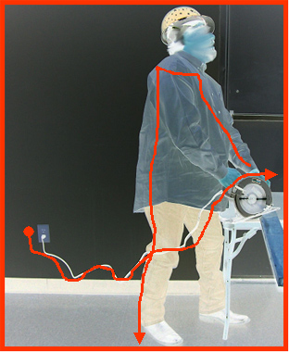
How Electricity Works
However, if the tool is damaged, the person may come in contact with the electricity and can become a path for the current.
The person will be shocked!
Notes:
If you have a defective electrical tool, frayed wire, bad outlet or other electrical hazard, you may come in contact with the electrical current. When you contact electrical current, the results may be deadly.
There are 3 main types of electrical injuries: electrical shock, electrocution and burns. You may receive an electrical shock, be burned by the electricity or by thermal contact, or be electrocuted and die. In addition, one can fall from an elevated surface such as a ladder as the result of an electrical hazard. Note: Burns usually occur on the hands. Burns occur when the electrical wiring or equipment is improperly used or maintained. Electrical burns cause tissue damage and are the result of heat generated by the current’s flow through the body. Flash burns are caused by high temperatures near the body produced by an electrical arc. Thermal contact burns occur when the skin comes in contact with overheated electrical equipment or when clothing is ignited by electricity.

Slide 9
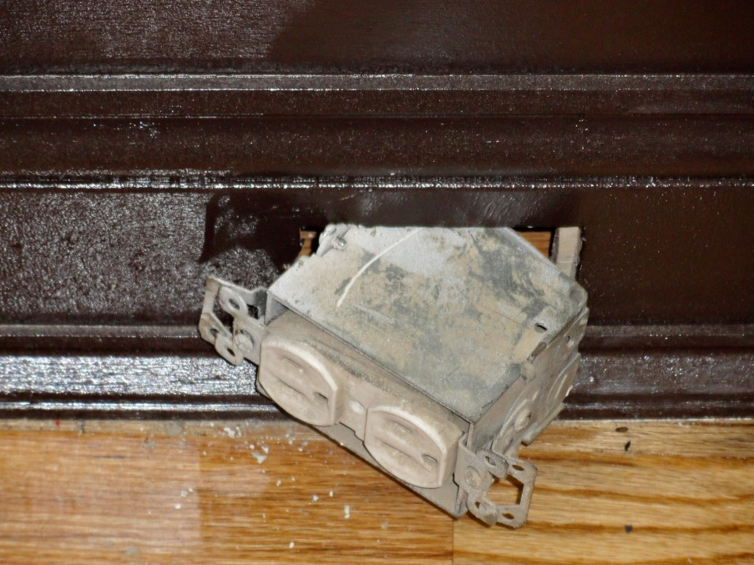
How Electricity Works
If you have a defective electrical tool, frayed wire, bad outlet or other electrical hazard, you may come in contact with the electrical current.
When you contact electrical current, the results may be deadly.
Notes:
There are 3 main types of electrical injuries: electrical shock, electrocution and burns. You may receive an electrical shock, be burned by the electricity or by thermal contact, or be electrocuted and die. In addition, one can fall from an elevated surface such as a ladder as the result of an electrical hazard.
Note: Burns usually occur on the hands. Burns occur when the electrical wiring or equipment is improperly used or maintained. Electrical burns cause tissue damage and are the result of heat generated by the current’s flow through the body. Flash burns are caused by high temperatures near the body produced by an electrical arc. Thermal contact burns occur when the skin comes in contact with overheated electrical equipment or when clothing is ignited by electricity.

Slide 10
Electrical Hazards
The following is a list of common electrical hazards found on construction sites:
Improper grounding
Exposed electrical parts
Inadequate wiring
Overhead power lines
Damaged insulation
Overloaded circuits
Wet conditions
Damaged tools and equipment
Notes:
In order to reduce the risks of contacting electrical current, you must learn to recognize and identify electrical hazards. Once a hazard has been identified, it must be corrected. If you do not have the qualifications, skills and abilities to correct the hazard, then you must report the hazard to your foreman, supervisor or someone who can get the hazard corrected.
The purpose of this program is to show you common hazards so that you recognize them and get them corrected. Hazard recognition is the key. It is better to recognize electrical hazards before they can harm you or a fellow worker.
We will be discussing each of the following common electrical hazards found on constructions sites:
Improper grounding
Exposed electrical parts
Inadequate wiring
Unsafe proximity to overhead power lines
Damaged insulation
Overloaded circuits
Working with electrical equipment in wet or very damp/humid conditions
Damaged tools and equipment

Slide 11
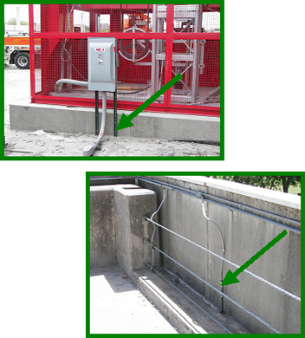
Improper Grounding
Grounding is the process used to eliminate unwanted current.
A ground is a physical electrical connection to the earth.
Notes:
Grounding is the process used to eliminate unwanted current. A ground is a physical connection to the earth. This allows leakage current to dissipate to the ground instead of going through the worker and possibly causing an injury.

Slide 12
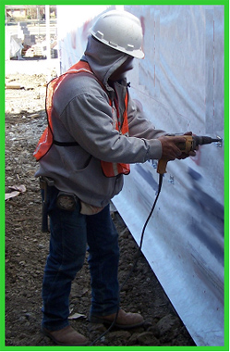
Improper Grounding
Electrical equipment must be properly grounded.
Grounding reduces the risk of being shocked, burned or electrocuted.
Notes:
When a power tool is not grounded properly, a hazard exists because unwanted current cannot be safely eliminated. The metal parts of an electrical wiring system that we touch (switch plates, ceiling light fixtures, conduit, etc.) should be grounded and at 0 volts. If the system is not grounded properly, these parts may become energized. If you contact a defective electrical device that is not grounded (or grounded improperly), the electrical current will take the path of least resistance which will be YOU and you will be shocked.
The most common OSHA electrical violation is improper grounding of equipment and wires.

Slide 13
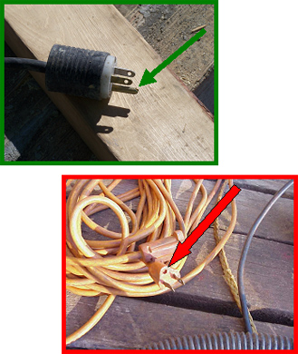
Improper Grounding
The ground pin safely returns leakage current to ground.
Never remove the ground pin.
Notes:
The ground pin in a flexible extension cord is designed to return leakage current back to ground. The path from the pin to the ground must be continuous in order to dissipate leakage current. If an extension cord has a broken ground pin or plug, it may not provide a continuous path to ground. This is an electrical hazard and should be corrected immediately.
Many times the ground pin is removed so the plug will fit into a two hole outlet. Other times the pin is damaged due to rough handling. Without the pin, the path to ground does not exist and your body is at risk of becoming part of the circuit and receiving an electrical shock. Never remove the ground pin from a flexible extension cord.

Slide 14
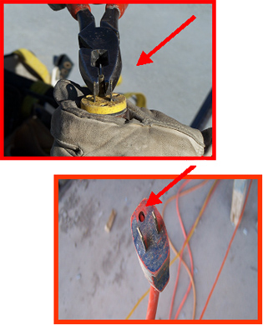
Improper Grounding
Removing the ground pin removes an important safety feature.
You can get shocked!
Notes:
When you remove the ground pin, you have removed one of the most important safety features built into the flexible extension cord. Without the direct path to ground, any leakage current has the potential to shock and injure you!
NEVER use an extension cord or electric tool that has a broken or missing ground pin!

Slide 15
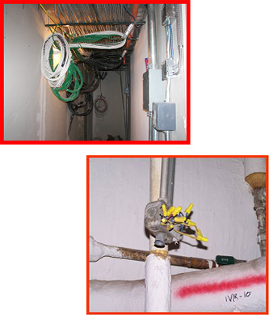
Exposed Electrical Parts
Exposed wires or terminals are hazardous.
Report these conditions to your supervisor.
Notes:
When covers of electrical panels or equipment are broken, incomplete, or missing, they create a serious hazard. Some electrical hazards to lookout for are:
Wires or other electrical parts that are exposed.
Covers removed from a wiring or breaker box.
Missing breakers from a panel box exposing the wires or terminals.
Overhead wires coming into the jobsite that may be exposed.
Exposed electrical terminals in motors, appliances, and electric equipment.
Older equipment that may have exposed electrical parts.
If you contact exposed live electrical parts, you will be shocked and possibly injured severely.
You need to recognize that an exposed electrical component is a hazard. If you see these conditions, report them to your supervisor immediately.

Slide 16
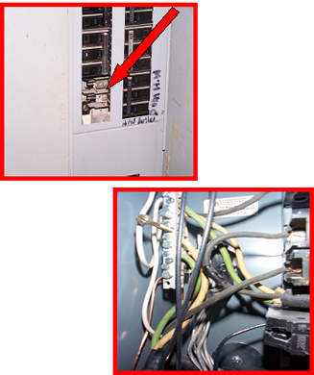
Exposed Electrical Parts
This electrical panel has missing circuit breakers.
Never use a panel that has exposed wires.
Notes:
In this example an electrical panel has exposed wires due to missing circuit breakers. Never use a panel that has exposed wires.

Slide 17
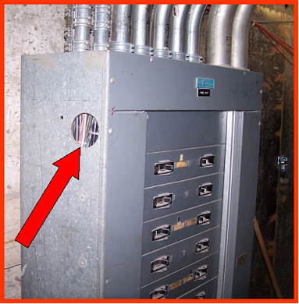
Exposed Electrical Parts
All openings must be closed.
Notes:
Openings in panel boxes, junction boxes, and any other electrical boxes must be closed with approved covers and without missing knockouts. The openings expose electrical parts and are electrical hazards.
In this picture, there is an opening in the electrical panel exposing the internal wires – this is very hazardous!

Slide 18
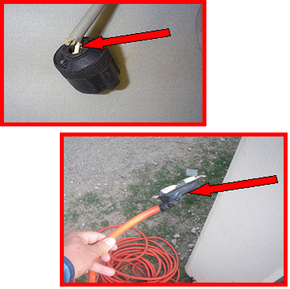
Exposed Electrical Parts
Outer insulation on electrical cords must be intact.
Notes:
Outer insulation on electrical cords must be intact. When the outer insulation pulls away from the plug, the inner wires are exposed. This can expose the internal wires to abrasions, breakage, and environmental conditions. The insulation should enter the plug completely, covering and protecting the inner wires.

Slide 19
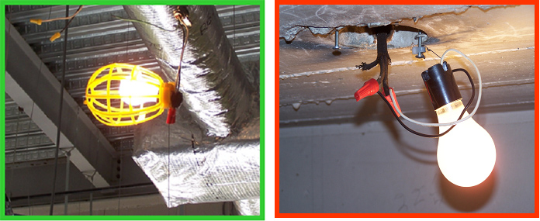
Exposed Electrical Parts
On construction sites, temporary lighting must be properly guarded and protected to avoid contact with broken bulbs and avoid potential shocks.
Notes:
Temporary lighting has to be done with safety in mind. Light fixtures should be properly grounded, with a cage around the bulb, and wires dressed properly. In the unsafe example, this bulb is exposed and could cause a serious eye injury or cuts if hit by an object. The bulb socket is also not properly grounded and could also cause a more serious injury if touched by a worker. You must always keep safety in mind when working near electricity.
Use proper illumination when working (this includes working during the night shift.)

Slide 20
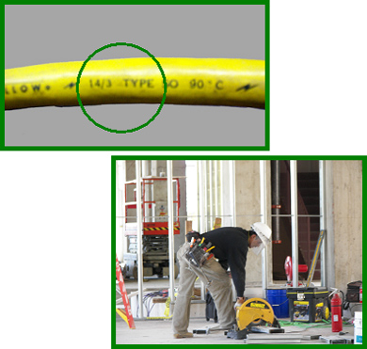
Inadequate Wiring
Use properly rated extension cords.
Make sure your power tools are being used with a properly rated extension cord.
Notes:
An electrical hazard exists when the gauge of the wire is too small for the current it will carry.
Normally, the circuit breaker is matched to the wire size. When the gauge of a wire is too small for the current it is supposed to carry, the wire will heat up. The heated wire could cause a fire.
Make sure to use properly rated extension cords when working with power tools. When you use an extension cord, make sure the gauge of the wire you are placing into the circuit is not too small for the equipment. Even if the circuit breaker is the right size, if the gauge of the wire is too small, you are creating an electrical hazard. A tool plugged into the extension cord may use more current than the cord can handle without tripping the circuit breaker. This could damage the tool in addition to causing a fire. Always make sure that any extension cord you are going to use is properly rated for the equipment you are going to plug into it.

Slide 21
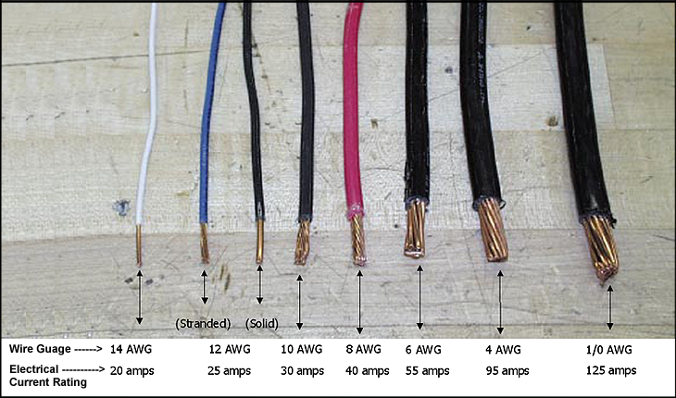
Inadequate Wiring
DIFFERENT TYPES OF WIRES WITH THEIR ELECTRICAL CURRENT RATING
Notes:
Electrical hazards result from using the wrong size or type of wire. You must avoid such hazards and create a safe work environment. You must choose the right size wire for the amount of electrical current expected in a circuit. The wire must be able to handle the current safely without heating up or tripping the circuit breaker. The wire’s insulation must be appropriate for the voltage and tough enough for the environment. Connections need to be reliable and protected.

Slide 22
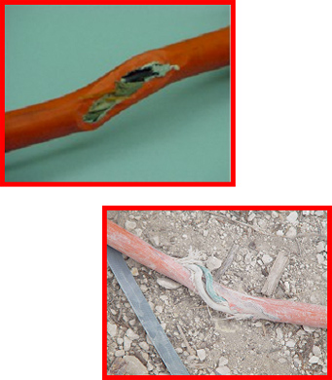
Damaged Insulation
Defective or inadequate insulation is a hazard.
Insulation prevents conductors from contacting each other or you.
Notes:
Insulation that is defective or inadequate is an electrical hazard. Usually, insulation is made of a plastic or rubber covering over the wires. Insulation prevents conductors from coming in contact with each other or people. Insulation also protects the wires from getting damaged due to the environment.
Electrical hazards can occur in many different ways and you should be aware of the possible situations. When insulation is damaged, exposed metal parts may become energized if a live wire inside touches them. Extension cords may have damaged insulation or the insulation inside an electrical tool may be damaged. Electric hand tools that are old, damaged, or misused may have damaged insulation inside. If you touch damaged power tools or other equipment, you will receive a shock. You are more likely to receive a shock if the tool is not grounded or not double-insulated. Double-insulated tools have two insulation barriers and no metal parts exposed.

Slide 23
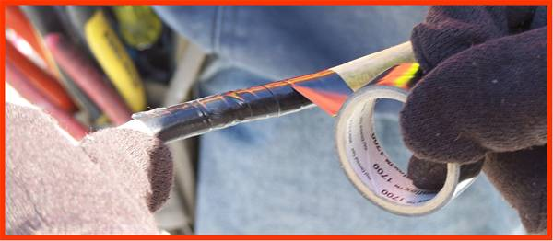
Damaged Insulation
Never attempt to repair a damaged cord with tape.
Notes:
When a flexible extension cord is damaged, it should be removed from service and replaced immediately. Most methods of repairing an extension cord do not maintain the original integrity of the insulation. Get a new cord.

Slide 24
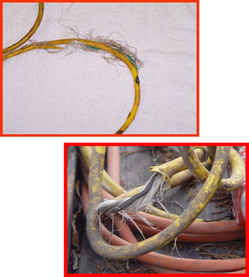
Damaged Insulation
Never use tools or extension cords with damaged insulation
Notes:
This flexible extension cord has damage to the outer insulation exposing the inner wires. The inner wires have also received damage to the insulation. Never use a tool or an extension cord in this condition.

Slide 25
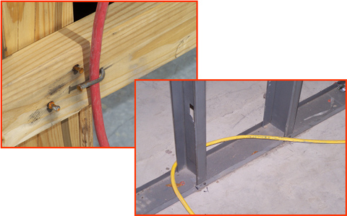
Damaged Insulation
Never hang extension cords from nails or sharp objects.
Notes:
When using flexible extension cords, be careful not to damage the insulation. Follow these three basic cautions:
Do not hang a cord from a nail or other sharp object that may damage the insulation.
Do not run cords through areas that may have sharp edges that can damage the cord.
Do not hang or drape an electrical cord on conductive objects. If they damage the cord, or if it is already damaged, the conductive surface may become energized and shock you or another worker

Slide 26
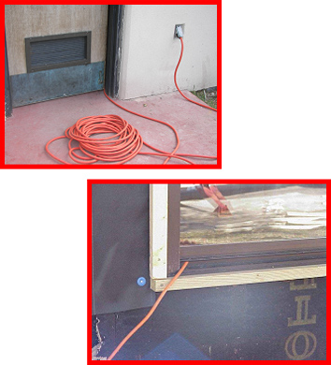
Damaged Insulation
Do not run extension cords through doors or windows.
Notes:
Do not run extension cords through windows, doors, walls or other areas where they could be cut, pinched or otherwise damaged. When a cord is pinched or cut, damage may occur to the inner wires without evidence on the outside.

Slide 27
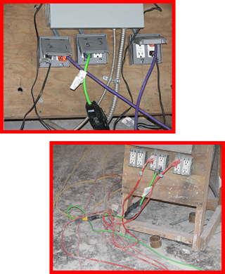
Overloaded Circuits
Overloaded circuits can cause fires.
Use proper circuit breakers.
Notes:
Overloads in an electrical system are hazardous because they can produce heat, arcing or even a fire. Wires and other components in an electrical system have a maximum amount of electrical current they can carry safely. If too many devices are plugged into a circuit, the electrical current will heat the wires to a very high temperature. If any one tool uses too much current, the wires will heat up also.
In order to prevent too much electrical current in a circuit, a circuit breaker or fuse is placed in the circuit. If there is too much current in the circuit, the breaker “trips” and opens like a switch. If an overloaded circuit is equipped with a fuse, an internal part of the fuse melts, opening the circuit. Both breakers and fuses do the same thing = open the circuit to shut off the electrical current. If the breakers or fuses are too big for the wires they are supposed to protect, an overload in the circuit will not be detected and the current will not be shut off. Overloading leads to overheating of circuit components (including wires) and may cause a fire.

Slide 28
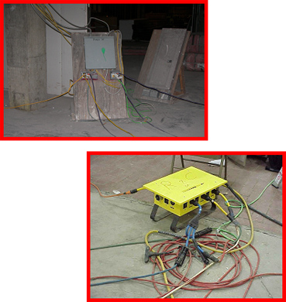
Overloaded Circuits
Never overload an outlet.
Notes:
Never overload an outlet by plugging too many cords into the same receptacle. Too much current will be pulled, the wires can overheat and may cause a fire!
The worse part of all is that sometimes the fires occur inside the walls. Because of that, sometimes it’s too late to stop the fire from spreading. So be very careful not to overload outlets or extension cords.

Slide 29
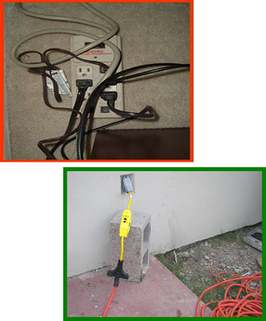
Overloaded Circuits
Do not use power strips or surge protectors on construction sites.
Instead, use a 3-way extension with a GFCI.
Notes:
Do not use power strips or surge protectors on a construction site, they are not designed for that use. Power strips are usually designed for home use and cannot be used with power tools on a construction site.
Power strips are very hazardous if used in wet areas.

Slide 30
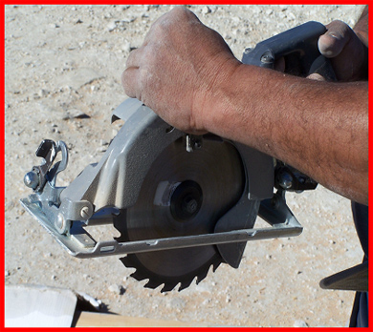
Damaged Tools & Equipment
Do not use electric tools that are damaged.
You may receive a shock or be electrocuted.
Notes:
Do not use electrical tools that are damaged. If you use tools that are damaged you may be shocked. Conductors may energize the tool and when you use it, the electrical current may pass through you. Be careful! if you suspect a tool is defective, report it to your supervisor or use another tool that you know is working properly.
Tag the one that is damaged or remove it from the area so nobody else uses it by mistake.

Slide 31
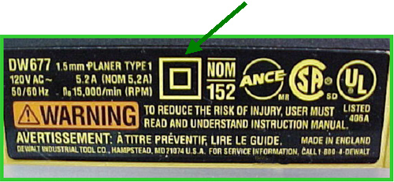
Damaged Tools & Equipment
Double insulated tools are labeled.
It will be marked “Double Insulated”.
It will have the following symbol:
Notes:
Whenever possible use double insulated tools. These tools are designed with a greater level of safety for the user.
In this picture, the outside case is plastic and keeps the worker insulated from the electrical parts.
You can tell if a tool is double insulated by looking at the label. It will be marked “Double Insulated” and have the “square inside a square” symbol.

Slide 32
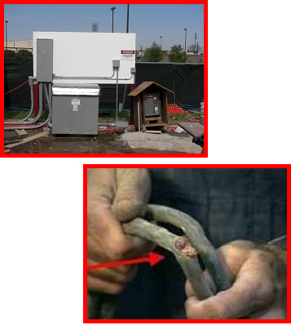
Wet Conditions
Damp, wet or humid conditions are very hazardous while working with electricity.
Damaged insulation increases the hazard.
Notes:
Anyone working with electricity in a damp, wet, or humid environment needs to exercise extra caution to prevent injury.
Working in wet, damp or humid conditions is hazardous because you may become an easy path for electrical current. If you touch a live wire or other electrical component—and you are well-grounded because you are standing in a small puddle of water—you will receive a shock and probably be either knocked out or killed.
Damaged insulation, equipment, or tools can expose you to live electrical parts. A damaged tool may not be grounded properly, so the housing of the tool may be energized, causing you to receive a shock.
Improperly grounded metal switch plates and ceiling lights are especially hazardous in wet conditions. But remember: you don’t have to be standing in water to be electrocuted. Wet clothing, high humidity, and perspiration also increase your chances of being electrocuted.

Slide 33
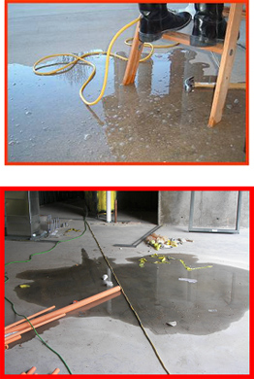
Wet Conditions
Always avoid using tools in wet, rainy or very humid locations.
Water increases the risk of electric shock.
Notes:
Always avoid using electric tools in wet, rainy or very humid locations. Any water or humidity will increase your risk of receiving an electric shock.
Remember, electrical current will always take the path with least resistance. That path is usually YOU -- especially if you’re standing in a puddle of water. So be extra careful and try to avoid working in these type of areas.

Slide 34
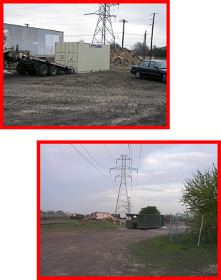
Unsafe Distances
From Overhead Power Lines
Survey the site for overhead power lines.
Never store materials or equipment under overhead power lines.
Notes:
Employees can become seriously injured or even killed if they come into contact with energized power lines. Always make sure you maintain a safe distance from power lines, especially when working with ladders or powered industrial trucks.

Slide 35
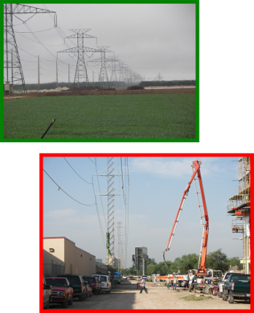
Unsafe Distances
From Overhead Power Lines
Maintain a distance of at least 10’ between tools and equipment and overhead power lines.
Power lines greater than
50 kV require greater distances.
Shocks and electrocutions occur where physical barriers are not in place to prevent contact with the wires.
Notes:
Today, most electrocutions involving overhead power lines are caused by failure to maintain proper work distances. Shocks and electrocutions occur where physical barriers are not in place to prevent contact with the wires. When dump trucks, cranes, work platforms, or other conductive materials (such as pipes and ladders) contact overhead wires, the equipment operator or other workers can be killed. A similar electrical hazard is present when digging work is performed near underground power lines.
The estimated location of utility installations, such as sewer, telephone, fuel, electric, water lines, or any other underground installations that reasonably may be expected to be encountered during excavation work, shall be determined prior to opening an excavation. When underground facilities are exposed (electric, gas, water, telephone, etc.) they shall be protected as necessary to avoid damage. Where multiple cables exist in an excavation, cables other than the one being worked on shall be protected as necessary. When multiple cables exist in an excavation, the cable to be worked on shall be identified by electrical means unless its identity is obvious by reason of distinctive appearance. Before cutting into a cable or opening a splice, the cable shall be identified and verified to be the proper cable. The minimum distance for voltages up to 50kV is 10 feet. For voltages over 50kV, the minimum distance is 10 feet plus 4 inches for every 10 kV over 50kV. When working around overhead power lines and using ladders, be sure to use ladders made of non-conductive materials. Wood and plastic are materials that are “Non-Conductive.”

Slide 36
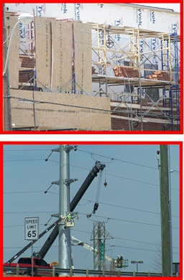
Unsafe Distances
From Overhead Power Lines
Maintain safe distances between scaffolding and overhead power lines.
Notes:
When working with scaffolding, you must stay clear of power lines - including when they are erected, used, dismantled, altered, or moved. Contact the power company and have the power shut-off to those lines while working near them. If that is not possible, have the power company insulate the lines. Always maintain the minimum safe distance of 10’ from the lines.
Make sure that any conductive materials, such as ladders, conduit, long handled tools, and any other conductive material, used on the scaffolding do not come near the power lines.

Slide 37
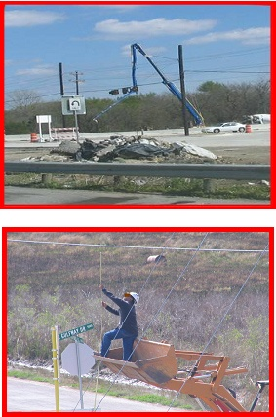
Unsafe Distances
From Overhead Power Lines
Overhead power lines are very dangerous.
Never attempt to contact an overhead power line.
Notes:
Because overhead power lines are very dangerous, you must always be extra careful when working near them. Remember, power lines carry higher voltage on them. If you or your equipment comes in contact with them you could risk electrocution and possibly death.

Slide 38
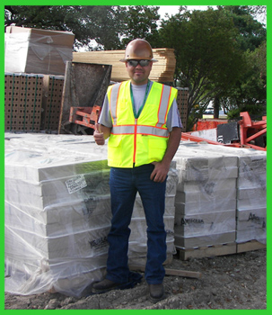
Accident Prevention
A willing, positive attitude towards safety will help make a safer work environment.
Notes:
A willing, positive attitude towards safety in the workplace will help make a safer environment. You must recognize potential hazards around you and make every effort to avoid and reduce hazards.

Slide 39
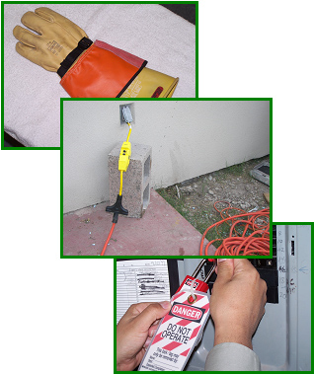
Accident Prevention
Always consider these safety precautions:
Personal protective equipment (PPE)
Use proper grounding
Use properly sized circuit breakers
Guard live electrical parts
Use properly flexible cords
Inspect tools, wiring, circuits and electrical systems. Use if in good working condition ("Do not overload circuits".)
Notes:
Electrical accidents can be extremely dangerous and often result in serious injury or death. When working with electricity always consider some of these safety precautions:
Personal protective equipment (PPE)
Use proper grounding
Use properly sized circuit breakers.
Guard live electrical parts
Use properly flexible cords
Inspect tools, wiring, circuits and electrical systems. Use if in good working condition ("Do not overload circuits".)

Slide 40
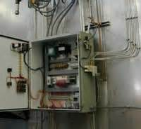
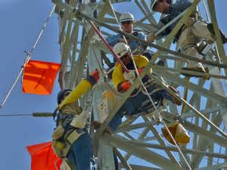
Accident Prevention
Ground fault circuit interrupters (GFCIs)
Have the utility company de-energize over head power lines and ground the lines.
Lock-out/tag-out
Close electrical panels
Notes:
Here are more safety precautions when working with/around electricity:
Ground fault circuit interrupters (GFCIs)
Have the utility company de-energize over head power lines and ground the lines.
Lock-out/tag-out.
Close electrical panels
Separate the two bullets: use proper guarding use properly sized circuit breakers

Slide 41
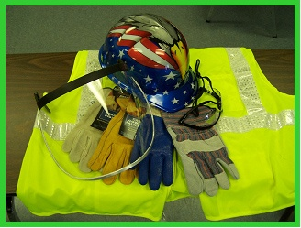
Personal Protective Equipment
PPE for electrical hazards include:
Hardhats
Rubber or insulating gloves rated for the electrical hazards at the worksite.
Insulating clothing
NEVER use damaged PPE!
Notes:
When exposed to possible electrical hazards Personal Protective Equipment (PPE) can be used for an additional measure of safety. Such PPE includes hardhats, rubber or insulating gloves rated for the electrical hazards at the worksite, and insulating clothing. It is important to use the proper PPE when protecting yourself from electrical hazards. NEVER use damaged PPE.

Slide 42
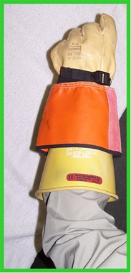
Personal Protective Equipment
Use appropriate rubber insulating gloves.
Make sure the gloves fit properly.
Make sure the glove rating matches with the work to be performed.
Not all gloves can be used to prevent electric shock.
Notes:
When performing work that may bring you in contact with electrical energy you should use the appropriate rubber insulating gloves. However, not all gloves can be used when working with electricity. The glove rating must match the work to be conducted.
You must be trained in the use of specific types of gloves before working with electricity.

Slide 43
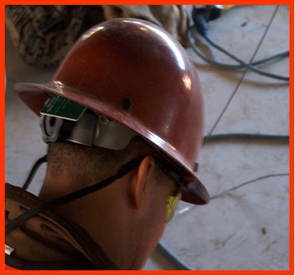
Personal Protective Equipment
Hard hats offer protection.
Hard hats are rated for certain uses.
Metal hard hats SHOULD NOT be used when working close to electrical lines.
Notes:
Hard hats offer protection so you do not contact electric current with your head. Hard hats are rated for certain uses. Be sure to use the appropriately rated hard hat. Never use a metal or fiber-metal hard hat like the one in this picture when working with electrical equipment.

Slide 44
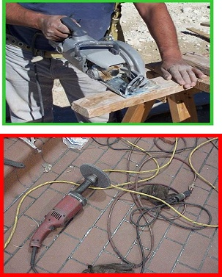
Inspect Tools & Cords
Inspect tools and cords completely before using for:
cracks
damaged insulation
broken ground pins
frayed line cord
loose parts
any other damage
Notes:
As an everyday routine at work or home, before using any electrical tool or extension cord, be sure to inspect it completely for:
Cracks
Damaged insulation
Broken ground pins
Frayed line cords
Loose parts
Any other damage
Being aware of electrical hazards can prevent serious injuries and possibly save your life!
Water or dampness near electrical circuits, wires, outlets, or power tools can be a warning sign of an electrical hazard. Warm tools, wires, cords, or connection boxes can also be a warning sign. Using the wrong electrical tool is an electrical hazard.

Slide 45
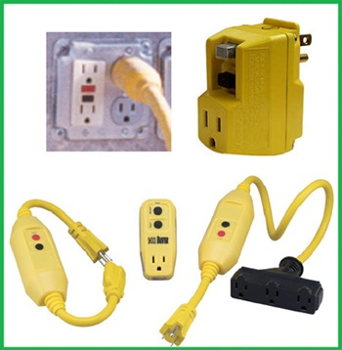
CGFI
OSHA requires the use of GFCIs on all construction sites.
Notes:
Ground Fault Circuit Interrupter.
OSHA ground-fault protection rules and regulations are necessary for employee safety and health. Therefore, it is the employer’s responsibility to provide either: (a) GFCIs on construction sites for receptacle outlets in use and not part of the permanent wiring of the building or structure; or (b) a scheduled and recorded assured equipment grounding conductor program on construction sites, covering all cord sets, receptacles which are not part of the permanent wiring of the building or structure, and equipment connected by cord and plug which are available for use or used by employees.
The employer is required to provide approved GFCIs for all 120- volt, single-phase, 15- and 20-ampere receptacle outlets on construction sites that are not a part of the permanent wiring of the building or structure and that are in use by employees. If a receptacle or receptacles are installed as part of the permanent wiring of the building or structure and they are used for temporary electric power, GFCI protection shall be provided. Receptacles on the ends of extension cords are not part of the permanent wiring and so the cord’s receptacle must be of the GFCI type whether or not the extension cord is plugged into permanent wiring. These GFCIs monitor the current-to-the-load for leakage to ground. A GFCI that shuts off a circuit is a warning that there may be an electrical hazard. In addition to GFCI’s, the use of proper sized circuit breakers can offer protection from electrical hazards.

Slide 46
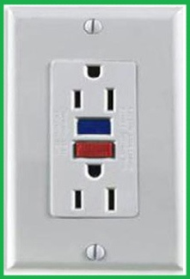
CGFI
A GFCI is a fast-acting circuit breaker.
It senses small imbalances in the circuit caused by current leakage to ground.
Notes:
A GFCI is a fast-acting circuit breaker that senses small imbalances in the circuit caused by current leakage to ground and, in a fraction of a second, shuts off the electricity.

Slide 47
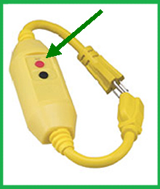
CGFI
It continually matches the amount of current coming and going to an electrical device.
The GFCI looks for a difference of approximately 5 milliamps
Notes:
The GFCI continually matches the amount of current going to an electrical device against the amount of current returning from the device along the electrical path. Whenever the amount “going” differs from the amount “returning” by approximately 5 milliamps, the GFCI interrupts the electric power within as little as 1/40 of a second.
When using a GFCI it is important to test the GFCI and make sure it is working properly. Just press the button marked “Test” and it will trip the device. No electricity will pass. Secondly press the button marked “Re-set” and the device is ready for use.

Slide 48
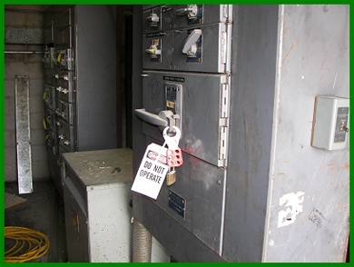
Lock-out/Tag-out
Workers must ensure electricity is off and “locked-out” before work is performed.
Notes:
Using a lock-out/tag-out (LOTO) program is another way to keep workers safe when working with electricity. Before any work is performed on electrical systems, workers must ensure the equipment is off and “locked-out”. The following is an overview of the Lock-out/Tag-out program.
When working with electricity, turning the equipment off is not enough. Someone could turn the equipment back on unaware of the worker, or there could be stored electrical energy in some electrical components even if the equipment is turned off. Before working on the electrical equipment, de-energize all circuits, deactivate controls, and lock-out and tag-out all de-energized circuits and equipment in the off position (those of non-cord type; machines that are cord and plug are to be unplugged).

Slide 49
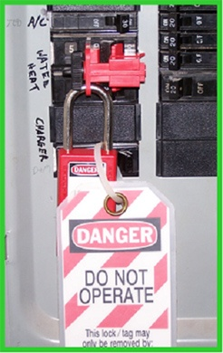
Lock-out/Tag-out
Once the on/off switch is securely locked out:
The switch must be tagged.
The tag lets others know why the switch is off.
Notes:
Once the on/off switch is securely locked out, the switch must be tagged. The tag serves as a warning to let others know why the switch has been turned off.
In case only a tag system (tag-out) is used to prevent the equipment to be re-energized, employers must train employees in the following limitations of tags:
Tags are essentially warning devices affixed to energy isolating devices and do not provide physical restraint on those devices as the restraint provided by a lock.
When a tag is attached to an energy isolating means, it is not to be removed without authorization of the authorized person responsible for it, and it is never to be bypassed, ignored, or otherwise defeated.
Tags must be legible and understandable by all employees.
Tags and their means of attachment must be made of materials which will withstand the environmental conditions encountered in the workplace.
Tags may evoke a false sense of security and their meaning needs to be understood as part of the overall energy control program.
Tags must be securely attached to energy isolating devices so that they cannot be inadvertently or accidentally detached during use.
The tag-out device must be a prominent warning device, such as a tag and a means of attachment, which can be securely fastened to an energy isolating device in accordance with the established procedure.

Slide 50
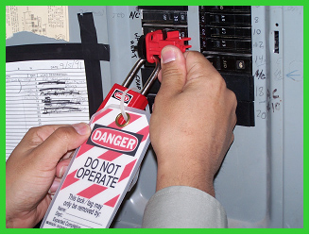
Lock-out/Tag-out
Locks and tags are warning signs.
You must be trained in lock-out/tag-out procedures.
Notes:
The lock and the tag are warning signs. If you see equipment that is locked and tagged, do not touch it. It is locked and tagged for a reason. If you are required to work on electrical equipment you must be trained in lock-out/tag-out procedures specific for that site.
Which employees should be trained and is it the same training?
Employees are trained so that they understand the purpose and function of the employer’s energy control program and so that employees acquire the knowledge and skills necessary for the safe application, usage and removal of the energy controls. The standard requires different levels of training for the three categories of employees.
What are the differences in the training required for the three categories?
Authorized employees must receive training on the recognition of applicable hazardous energy sources, the type and magnitude of the energy available in the workplace, and the methods and means necessary for energy isolation and control.
Affected employees must receive training on the purpose and use of the energy control procedure. Other employees (those whose work activities are or may be in an area where energy control procedures may be utilized) must be instructed about the procedure and about the prohibition relating to attempts to restart or reenergize machines or equipment that are locked or tagged out.

Slide 51
Questions

Slide 52
Contact Information
Health & Safety Training Specialists
1171 South Cameron Street, Room 324
Harrisburg, PA 17104-2501
(717) 772-1635
RA-LI-BWC-PATHS@pa.gov
Like us on Facebook! - https://www.facebook.com/BWCPATHS

Slide 53
Working Team for this PPT
UNIVERSITY OF PUERTO RICO
MEDICAL SCIENCES CAMPUS
Graduate School of Public Health, Dep. of Environmental Health
Sergio Caporali, Ph.D., CSP – Principal Investigator
Lida Orta-Anés, Ph.D., Field Trainer
Marcilyn Colón Colón, MSc., Training Coordinator
Harlyn Rivera, Administrative Assistant

Slide 54
Working Team for this PPT
CONTRACTORS
Circe E. Niezen, ME, MBA, Training Evaluator, PUPR
Mark Fullen, Ph.D. Candidate, Field Trainer and Curriculum Developer, WVU
Carmen Vázquez, RN, Field Trainer
Migdalia Ruiz, MS, Field Trainer
Carlos Ortiz, Ph.D., Online Training Administrator, UPR-CPRS-OIRE
Eliel Melón Ramos – Online Training Adm. Assistant, UPR-CPRS-OIRE

